Slide 1

Wild-Ireland
Educational Wildlife application that teaches through a first-person game.
By Jake Bolger

Slide 2



Background
Interactive experience
3D Game
Teaching students

Slide 3





Project Idea
1. Create an educational tool.
2. Learn about wildlife in Ireland.
3. Through a 3D first person game.
4. Explore and examine wildlife.
5. Access to information and ability to test the knowledge.

Slide 4



Research
Existing Applications
Technologies
Other Research

Slide 5
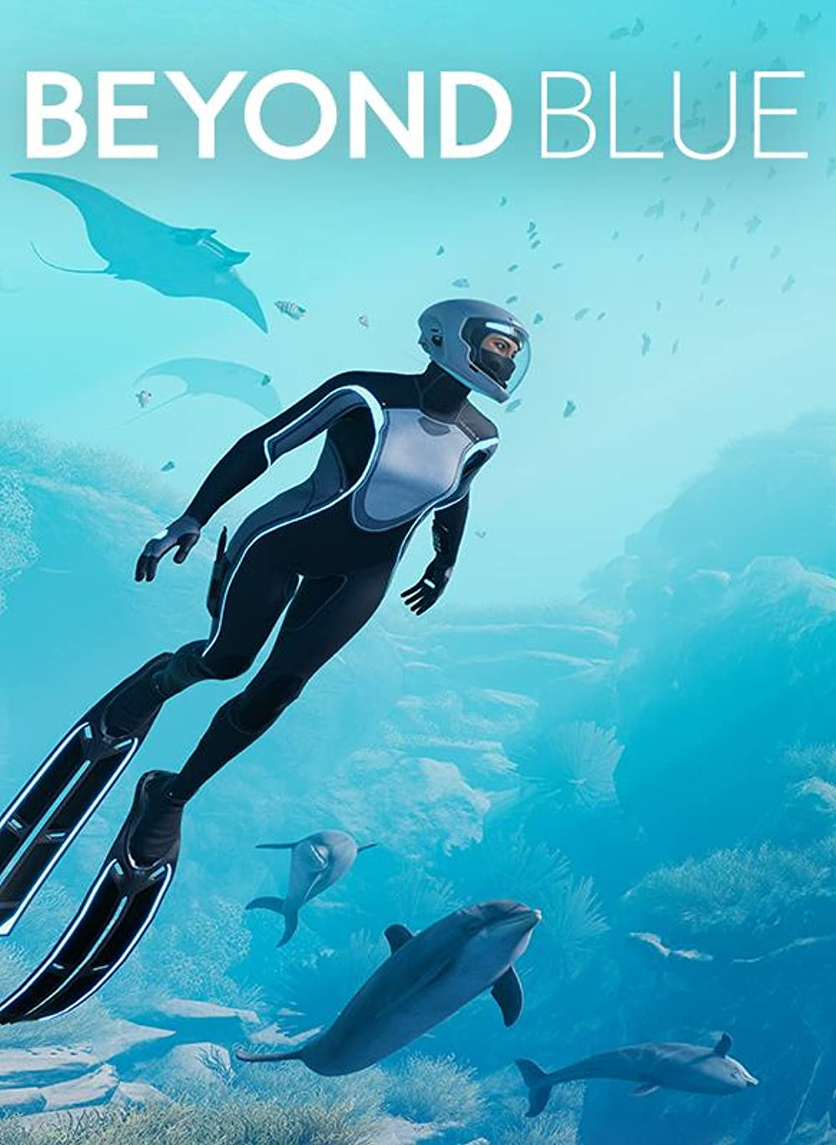
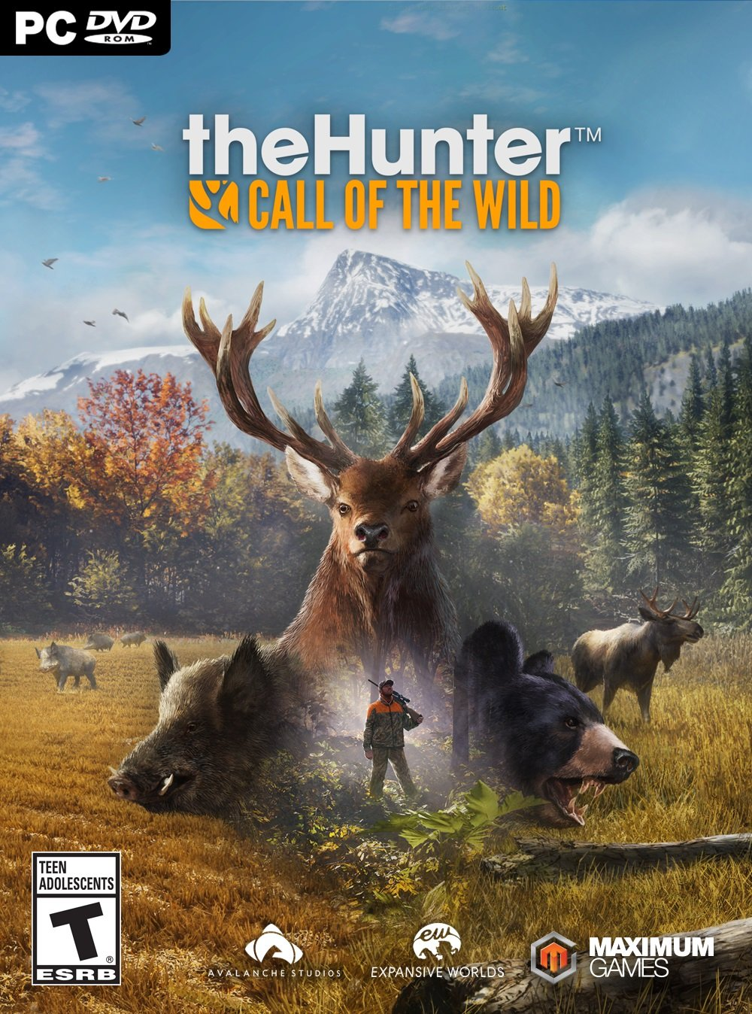
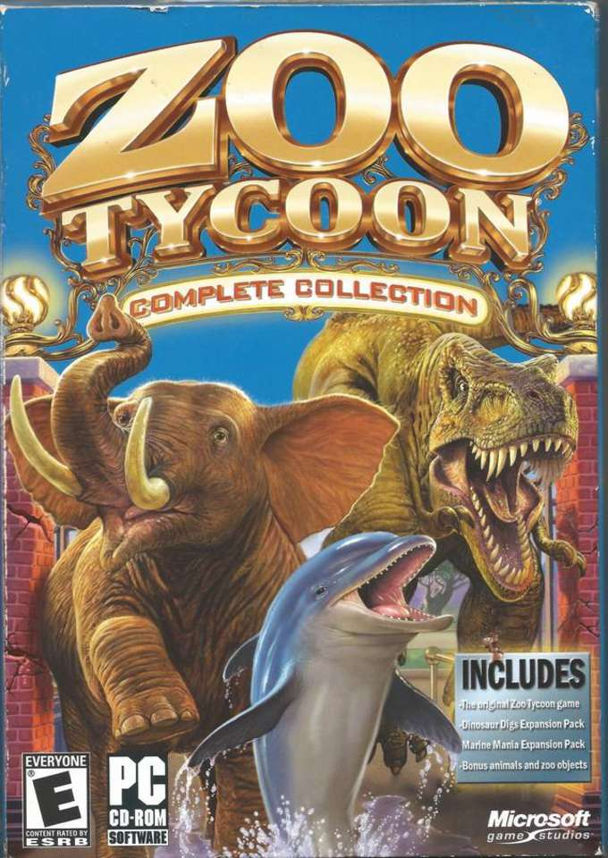
Existing Applications
1. Beyond Blue
2. The Hunter: Call of the Wild
3. Zoo Tycoon

Slide 6




Technologies
Game Engine
3D Modelling
Programming Language
Script Editor

Slide 7










Other Research
Cutscene
Inventory system
Inspection system
Save System
Procedural generation
AI research
Animation techniques
Audio
Assets
Final Year Projects

Slide 8
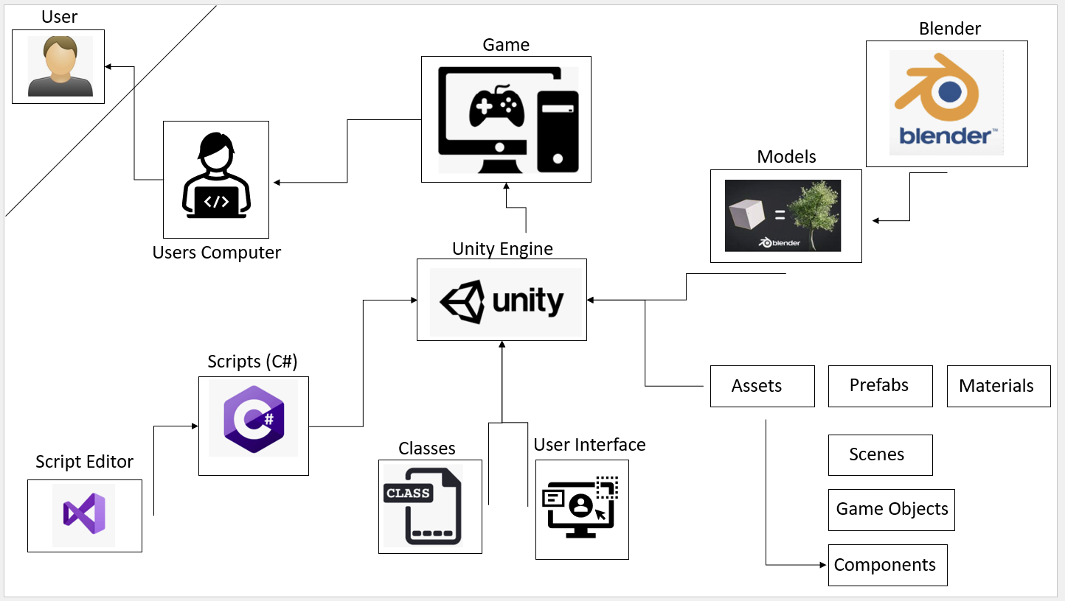
Design

Slide 9
System Design
Cutscenes – Unity Timeline, Microsoft Edge.
Inspect system – classes.
Inventory system – classes.
Save system – Binary Files.
Procedural animation – Ray casting etc.
6. Map / Level Design – Perlin noise.
7. Animal AI – Pathfinding.
8. Art – low poly.
9. Models – Animals, Trees.
10. Audio – Nature Sounds, Music.

Slide 10
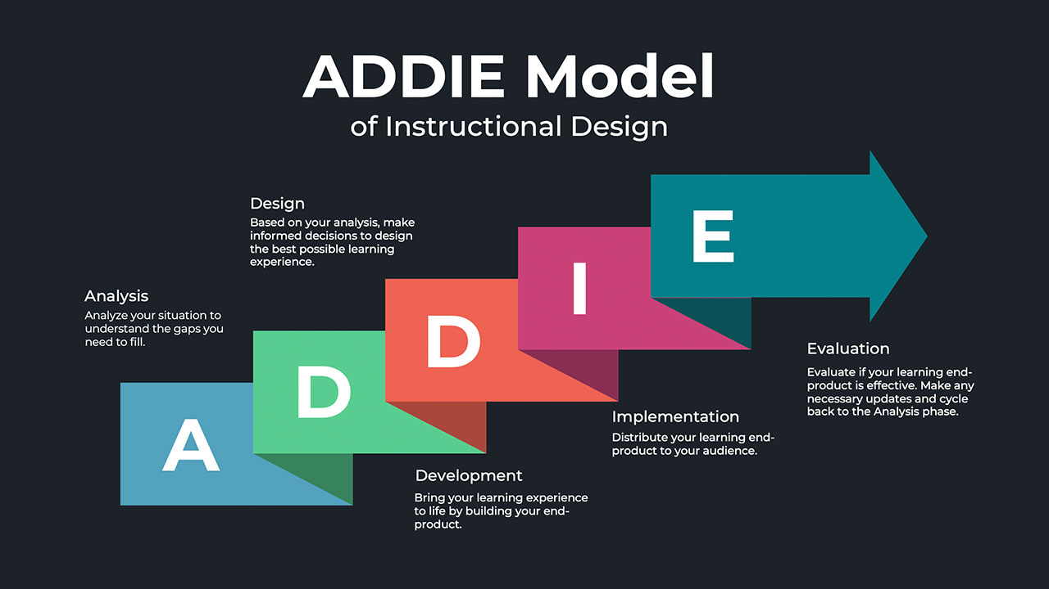
Educational approach
ADDIE Model
Information: Videos, Text, Pictures.
Quizzes

Slide 11
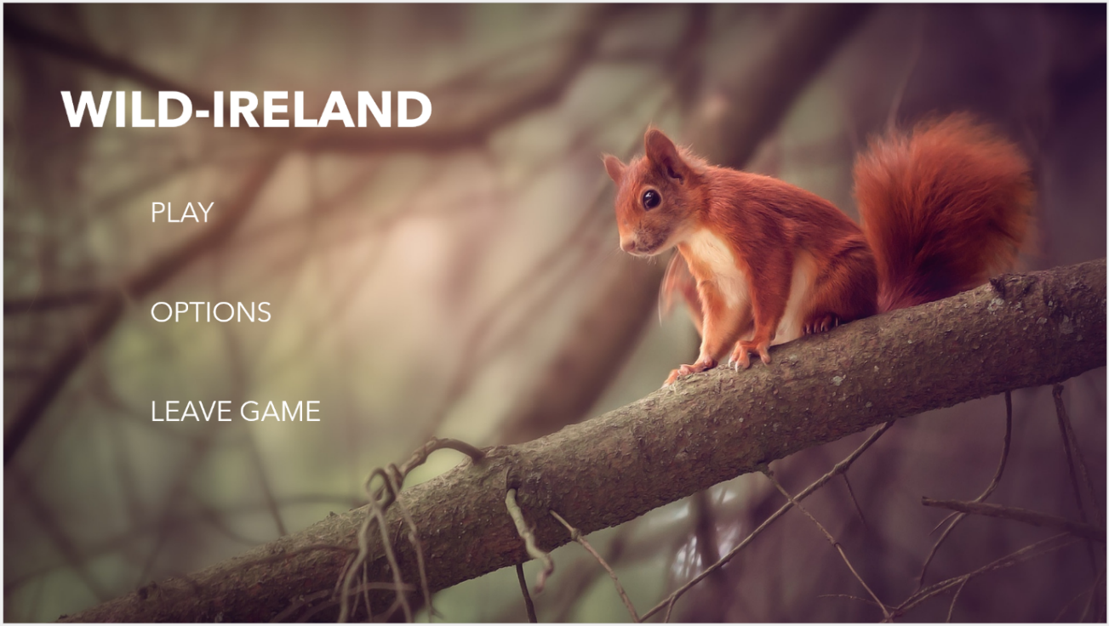
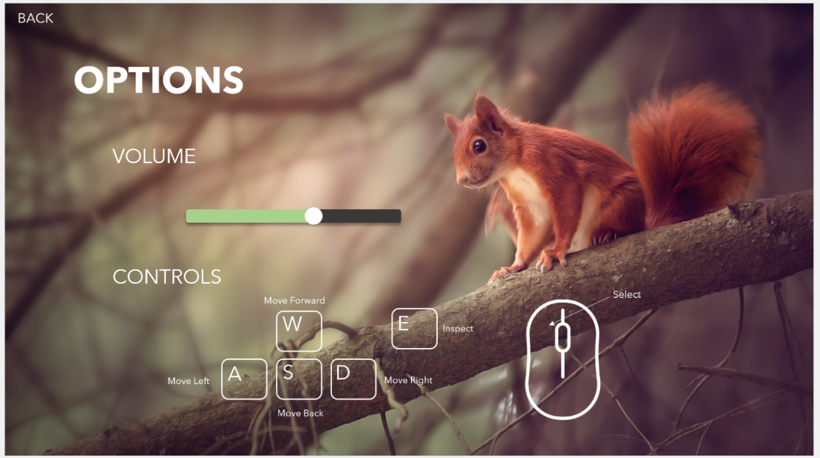
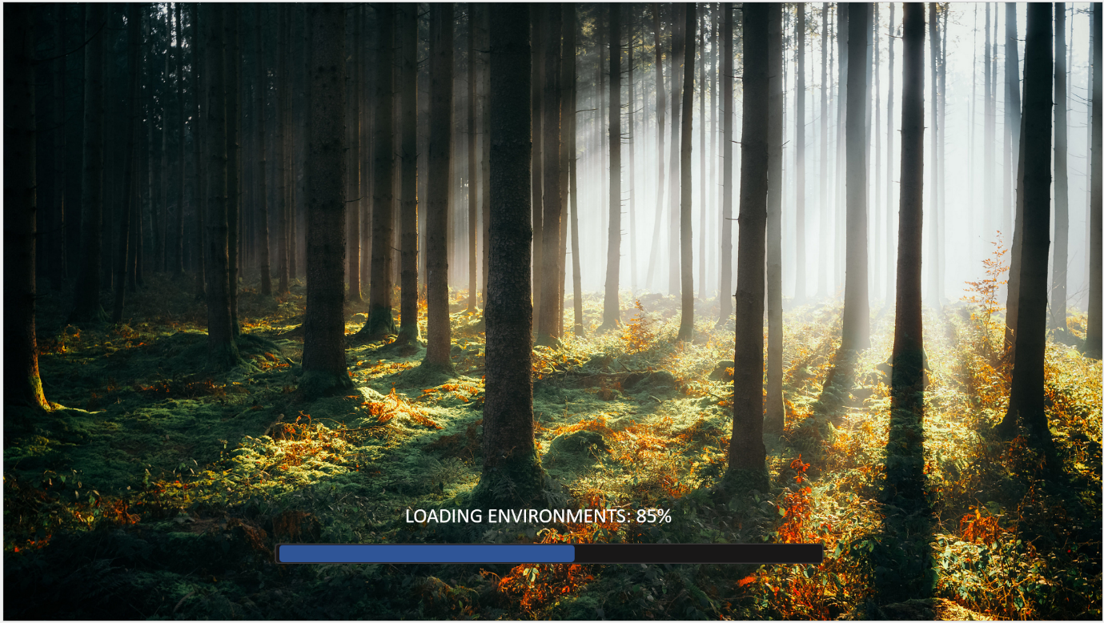
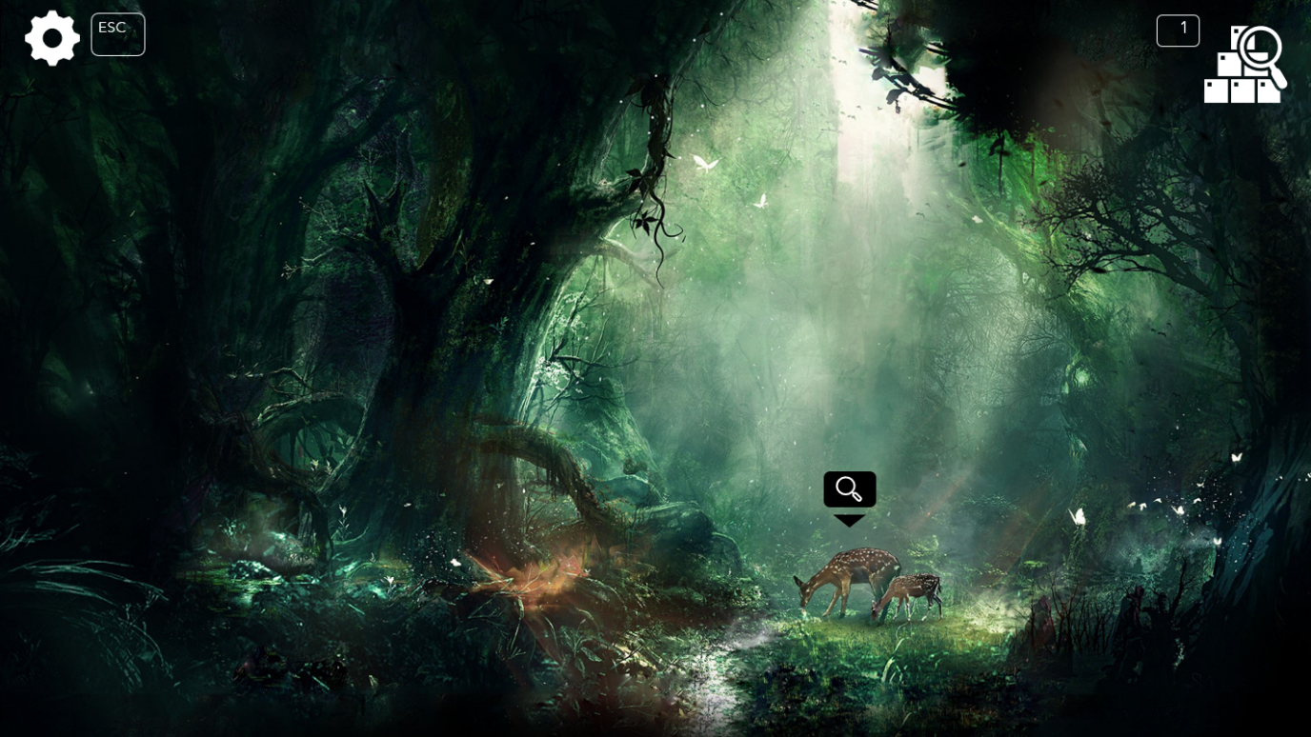
Front end

Slide 12
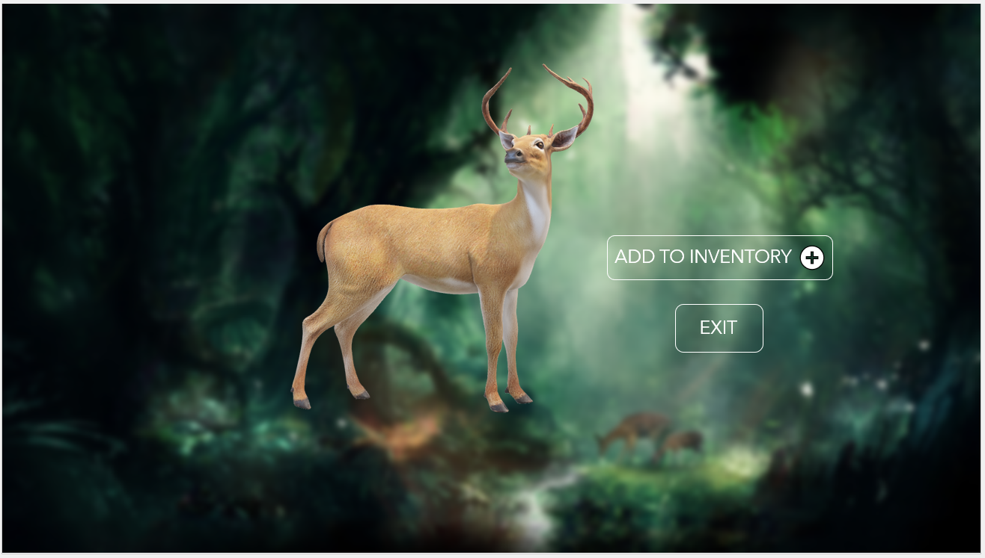
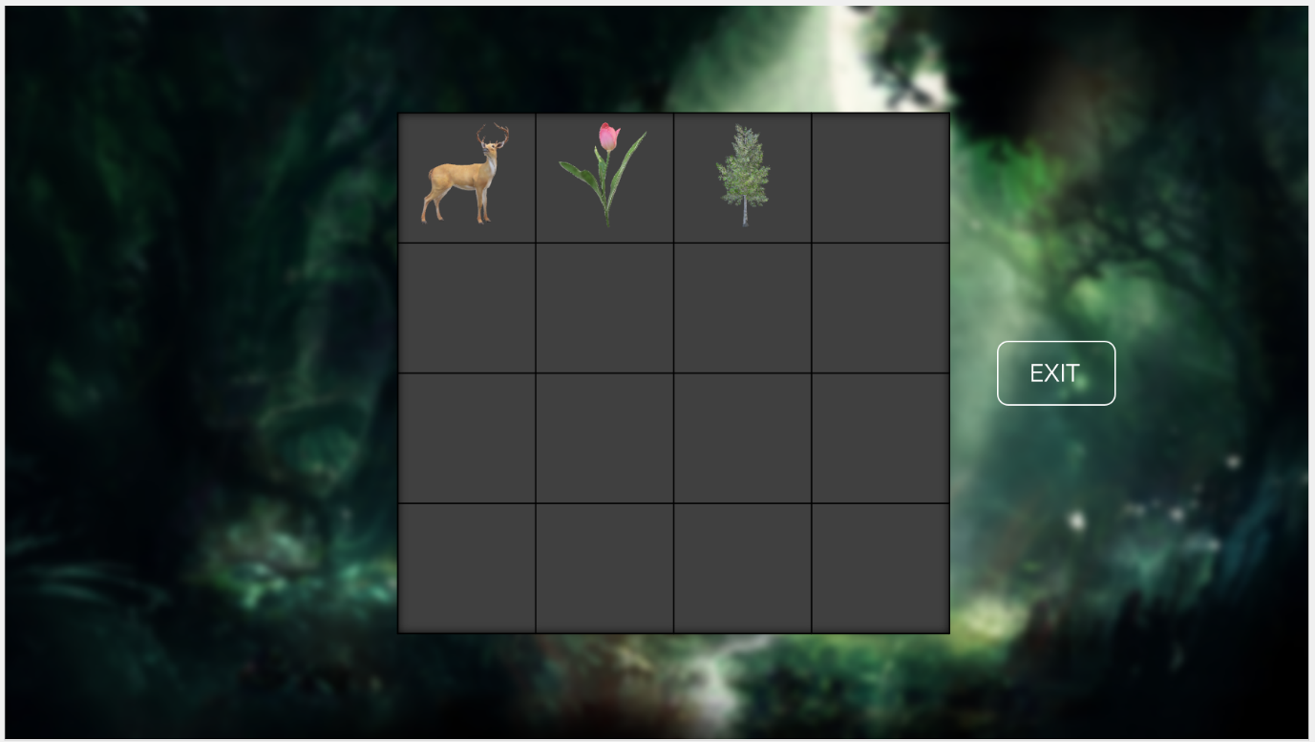
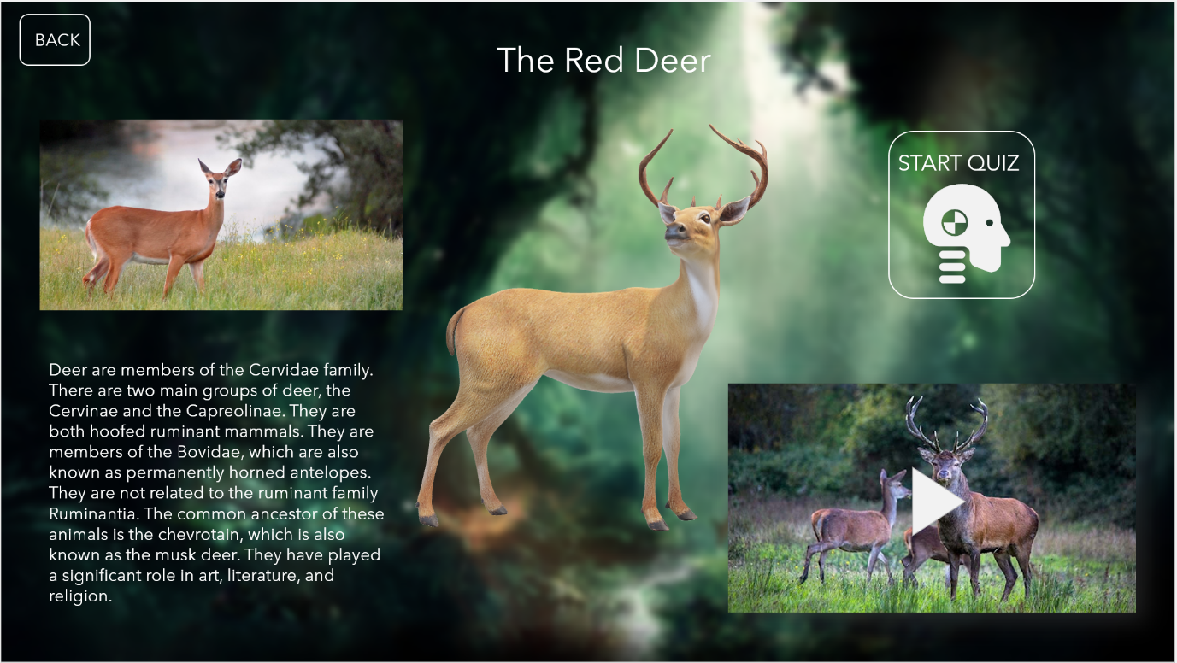
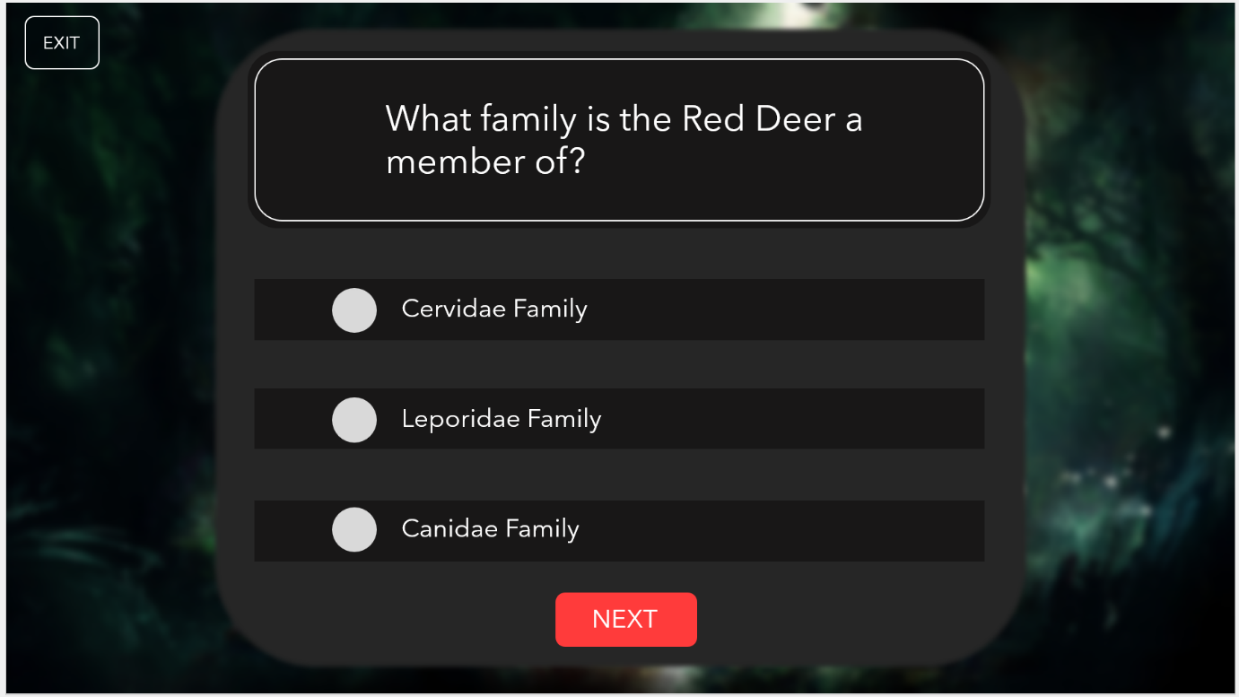

Slide 13
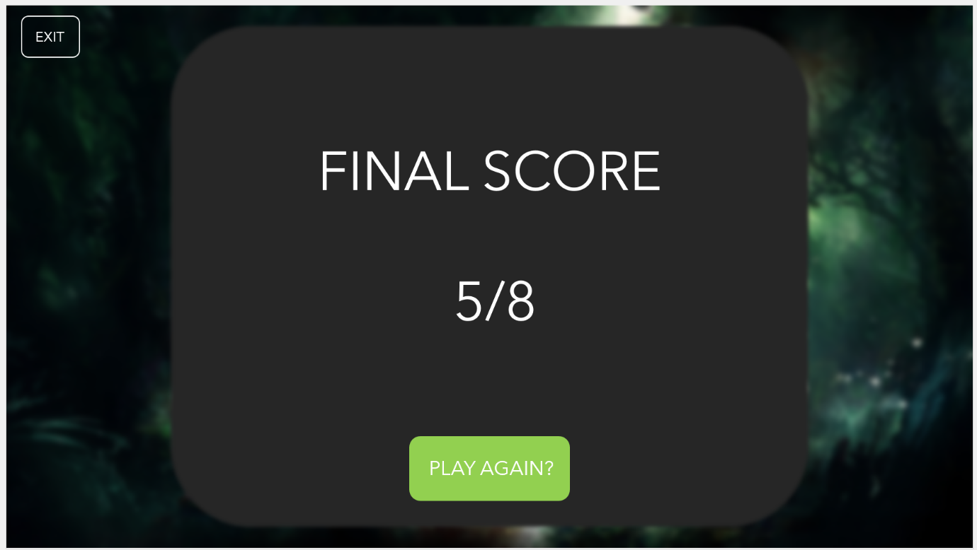
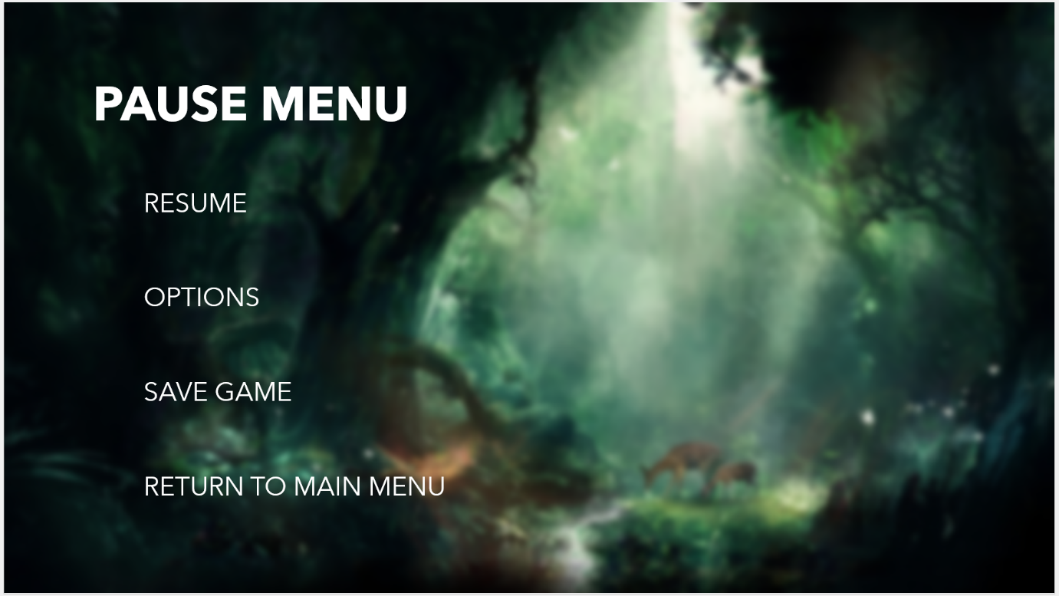
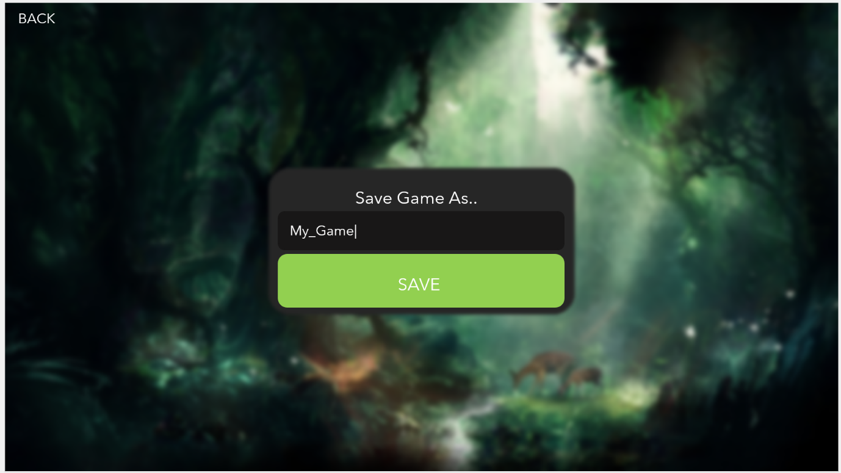
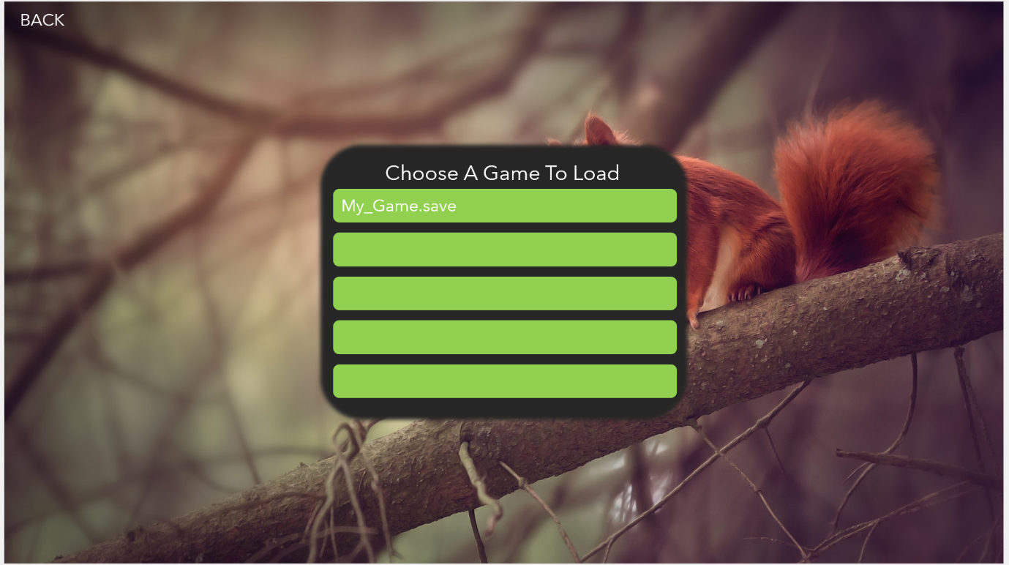

Slide 14
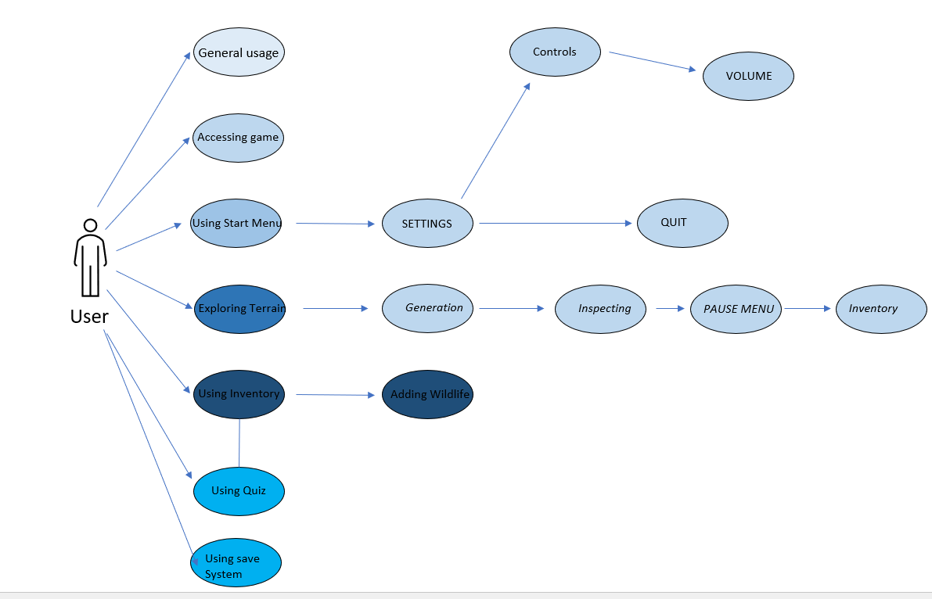
Use Cases

Slide 15
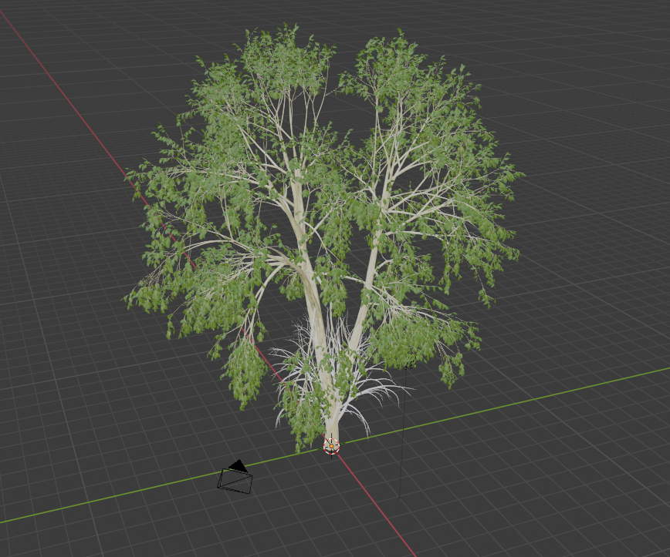
Complexity
Inventory, Inspection and Save system
Procedural Generation
Environment
Procedural Animation
AI
Pathfinding
Custom Models.
Blender

Slide 16

Testing
White and Black Box Testing
Testing in Unity
Test Plan

Slide 17

Issues and Future Work
Biggest Challenge
Plans for Future Work
Follow Gantt Chart
Main features will be implemented
Some aspects will be changed

Slide 18

Application Demo

Slide 19

Questions?

